Slide 1
Tech, Text and Zoom:
Self-care for your neck & back
Ginger Clark, LMBT, Yoga Instructor | UNC Health Wellness Centers

Slide 2
Tech, Text, and Zoom:
Self care for your sore neck and back
Increased work from home or office impacts your passive posture!
-learn mindfulness-based techniques
-practical movements to relax achy neck and shoulders
-tools to use at home

Slide 3
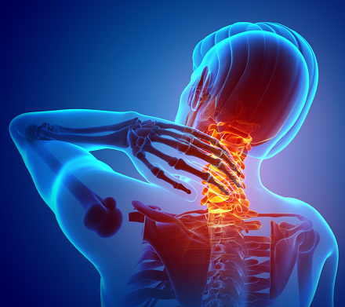
Some signs and symptoms of text neck syndrome include:
Sharp or achy pain in the neck and shoulders.
Stiffness/tightness in shoulders and neck leading to decreased R.O.M.
Intermittent or constant headaches
Temporomandibular joint (TMJ) problems — pain or dysfunction in the jaw joints and muscles
Nerve pain with tingling and numbness in the upper limbs
Eye fatigue

Slide 4
Mindfulness-Based Techniques

Slide 5
Prevent Eyestrain
~adjust lighting
~change dress code
~use the 20/20/20 rule

Slide 6
Hydration
Drink water and hot tea as a remedy for vocal strain and to help relax ~

Slide 7
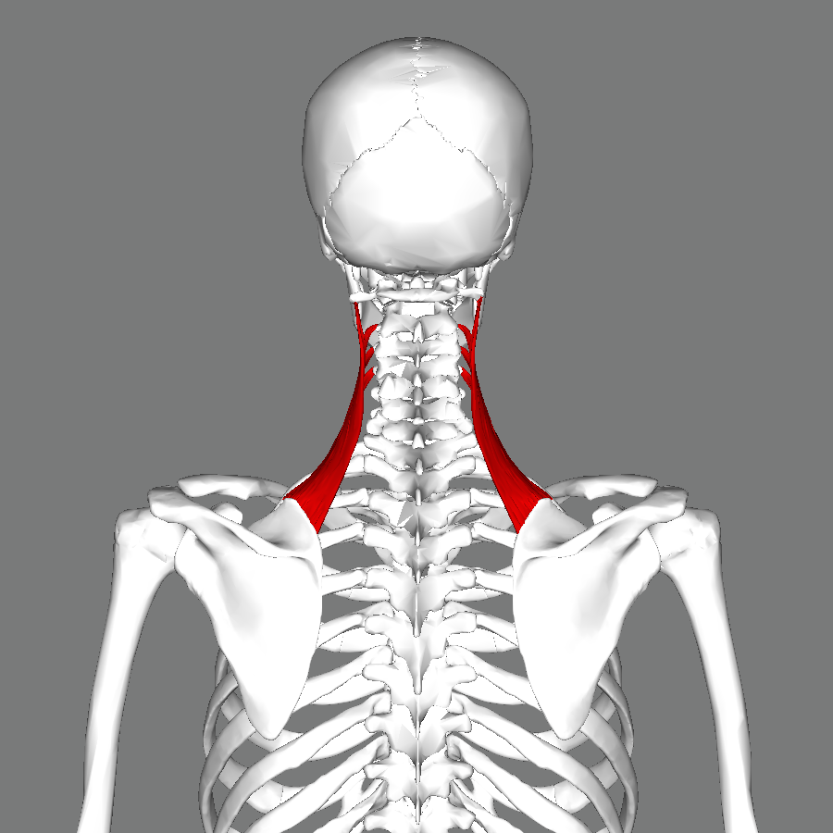
Practical Movements
~Counter poses
~Dynamic movements
~Seated Levator Scapulae Stretch
~Shoulder slowly raised
~Movement for the jaw

Slide 8
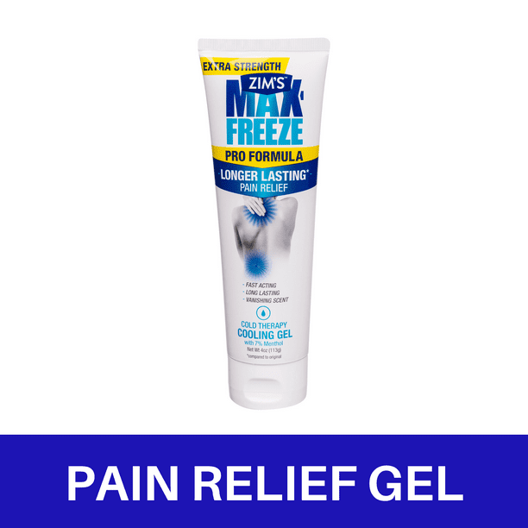
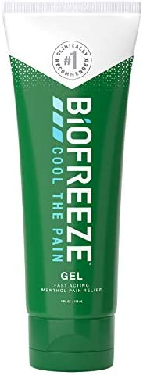
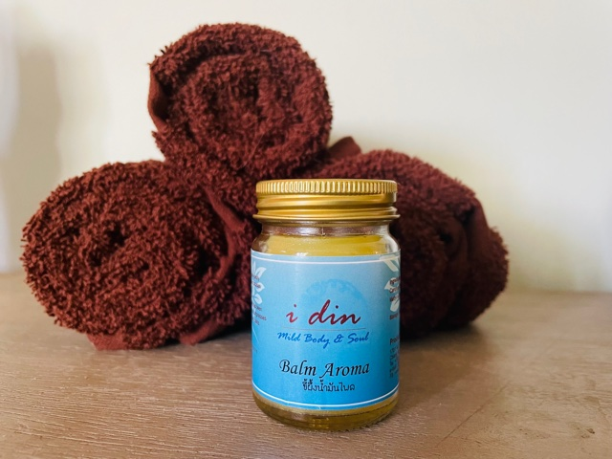
Topical Pain Relief
Biofreeze Active Ingredients: Menthol USP 5%
Maxfreeze Active Ingredients: Menthol (7 %)
Thai Herbal Massage Balm
https://livingsabai.com/shop/thai-herbal-massage-balm/
Ingredients: Sesame Oil, Clove, Turmeric, Plai, Camphor, Eucalyptus, and Menthyl salicylate.

Slide 9
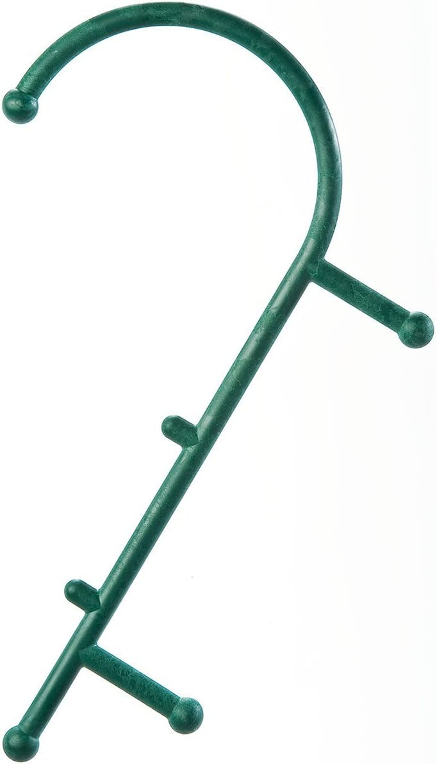
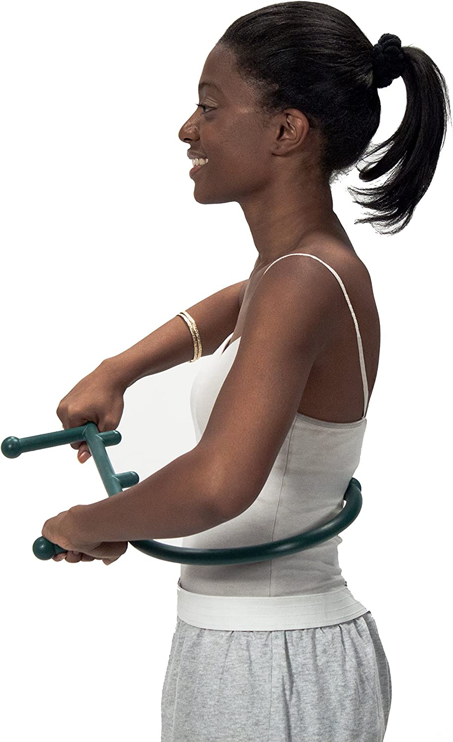
Tools to use at Home
ProStretch Addaday Junior+
Handheld Massage Roller
Addaday Marble Roller
Thera Cane Massager

Slide 10
Referrals & Insurance
How schedule massage at UNC Wellness Center:
Call (919) 966-5500 to schedule in Meadowmont (919-957-5900 for NW Cary)
Appointments are available 7 days/week, from the morning through the evening.
If unsure who to schedule with, the front desk can direct you to me to help select the right therapist for your needs.
All of our therapists can do medical, Swedish, deep tissue and neuromuscular massage.
Only certain therapists offer prenatal, hot stone, craniosacral, lymphatic drainage, shiatsu, Bodytuning, Healing Touch, Reiki, and Lomi Lomi
We do not file any insurance for services, but are happy to provide receipt of payment and session notes, if clients want to file for reimbursement with their insurance company.
We recommend the client contact their insurance company prior to scheduling in order to know if their insurance will reimburse for massage and what details the company will require for reimbursement.

Slide 11
Contact: Ginger Clark, LMBT, Yoga Instructor Massage Therapist UNC Wellness Centers (984) 974-2565 ginger.clark@unchealth.unc.edu

